Slide 1
Capital Improvement program fy2015/16 – fy2020/21
August 14, 2014

Slide 2
The Capital Improvement Program (CIP)
“The Capital Improvement Plan and the Capital Needs Assessment (CNA) - collectively referred to as the Capital Improvement Program - represent a statement of the County of Albemarle’s policy regarding long-range physical development for the next five-year and ten-year periods respectively. The Capital Improvement Program serves as a planning and implementation tool for the acquisition, development, construction, maintenance, and renovation of public facilities, infrastructure, and capital equipment. “

Slide 3
The CIP Review Process
June:
LRPAC Recommendation
August:
Staff Presentation & School Board Approval
September:
OMB + OFD Review Submission
October:
Technical Review Committee rank projects & Financial Review Committee meets
November:
Oversight Committee reviews TRC’s recommendation
December:
Joint Board Meeting to review recommendations
February:
County Executive submits final document to BOS
March:
BOS Work Session on capital budget + public hearings
April:
BOS Adopts Budget
Notes:
Staff will return August 28th for approval

Slide 4
LRPAC CIP Recommendation
RANK | PROJECT | FISCAL YEAR |  |  |  |  | 5 Year Total
 |  | 1 | 2 | 3 | 4 | 5
 |  | 15/16 | 16/17 | 17/18 | 18/19 | 19/20
1 | Maintenance | 5,820 | 7,307 | 6,340 | 6,936 | 6,280 | 32,683
2 | State Technology Grant | 752 | 752 | 752 | 752 | 752 | 3,760
3 | Instructional Technology | 575 | 650 | 650 | 650 | 650 | 3,175
4 | Administrative Technology | 261 | 261 | 263 | 263 | 263 | 1,311
5 | Telecommunications Network Upgrade |  | 900 | 500 | 500 |  | 1,900
6 | School Bus Replacement | 1,500 | 1,500 | 1,500 | 1,500 | 1,500 | 7,500
7 | Security Improvements | 561 | 704 | 715 |  |  | 1,980
8 | Red Hill Additions + Modernization | 441 | 5,473 |  |  |  | 5,914
9 | Stony Point Addition + Modernization | 337 | 4,357 |  |  |  | 4,694
10 | Learning Space Modernization | 744 | 6,064 | 7,437 | 9,108 | 9,636 | 32,989
11 | Woodbrook Addition + Modernization |  | 1,076 | 7,911 | 5,274 |  | 14,262
12 | WAHS Environmental Science Academy | 500 |  |  | 200 | 2,000 | 2,700
13 | Yancey Addition |  |  | 244 | 2,688 |  | 2,932
14 | Scottsville Addition |  |  |  | 334 | 3,544 | 3,877
Total |  | 11,491 | 29,045 | 26,312 | 28,205 | 25,113 | 120,165

Slide 5
Financial Reality
RANK | PROJECT | FISCAL YEAR |  |  |  |  | 5 Year Total
 |  | 1 | 2 | 3 | 4 | 5
 |  | 15/16 | 16/17 | 17/18 | 18/19 | 19/20
1 | Maintenance | 5,820 | 7,307 | 6,340 | 6,936 | 6,280 | 32,683
2 | State Technology Grant | 752 | 752 | 752 | 752 | 752 | 3,760
3 | Instructional Technology | 575 | 650 | 650 | 650 | 650 | 3,175
4 | Administrative Technology | 261 | 261 | 263 | 263 | 263 | 1,311
5 | Telecommunications Network Upgrade |  | 900 | 500 | 500 |  | 1,900
6 | School Bus Replacement | 1,500 | 1,500 | 1,500 | 1,500 | 1,500 | 7,500
7 | Security Improvements | 561 | 704 | 715 |  |  | 1,980
8 | Red Hill Additions + Modernization | 441 | 5,473 |  |  |  | 5,914
9 | Stony Point Addition + Modernization | 337 | 4,357 |  |  |  | 4,694
10 | Learning Space Modernization | 744 | 6,064 | 7,437 | 9,108 | 9,636 | 32,989
11 | Woodbrook Addition + Modernization |  | 1,076 | 7,911 | 5,274 |  | 14,262
12 | WAHS Environmental Science Academy | 500 |  |  | 200 | 2,000 | 2,700
13 | Yancey Addition |  |  | 244 | 2,688 |  | 2,932
14 | Scottsville Addition |  |  |  | 334 | 3,544 | 3,877
Total |  | 11,491 | 29,045 | 26,312 | 28,205 | 25,113 | 120,165
7,307
Current BOS Funding | 9,145 | 9,513 | 10,171 | 11,611

Slide 6
LRPAC CIP Recommendation
RANK | PROJECT | FISCAL YEAR |  |  |  |  | 5 Year Total
 |  | 1 | 2 | 3 | 4 | 5
 |  | 15/16 | 16/17 | 17/18 | 18/19 | 19/20
1 | Maintenance | 5,820 | 7,307 | 6,340 | 6,936 | 6,280 | 32,683
2 | State Technology Grant | 752 | 752 | 752 | 752 | 752 | 3,760
3 | Instructional Technology | 575 | 650 | 650 | 650 | 650 | 3,175
4 | Administrative Technology | 261 | 261 | 263 | 263 | 263 | 1,311
5 | Telecommunications Network Upgrade |  | 900 | 500 | 500 |  | 1,900
6 | School Bus Replacement | 1,500 | 1,500 | 1,500 | 1,500 | 1,500 | 7,500
7 | Security Improvements | 561 | 704 | 715 |  |  | 1,980
8 | Red Hill Additions + Modernization | 441 | 5,473 |  |  |  | 5,914
9 | Stony Point Addition + Modernization | 337 | 4,357 |  |  |  | 4,694
10 | Learning Space Modernization | 744 | 6,064 | 7,437 | 9,108 | 9,636 | 32,989
11 | Woodbrook Addition + Modernization |  | 1,076 | 7,911 | 5,274 |  | 14,262
12 | WAHS Environmental Science Academy | 500 |  |  | 200 | 2,000 | 2,700
13 | Yancey Addition |  |  | 244 | 2,688 |  | 2,932
14 | Scottsville Addition |  |  |  | 334 | 3,544 | 3,877
Total |  | 11,491 | 29,045 | 26,312 | 28,205 | 25,113 | 120,165

Slide 7
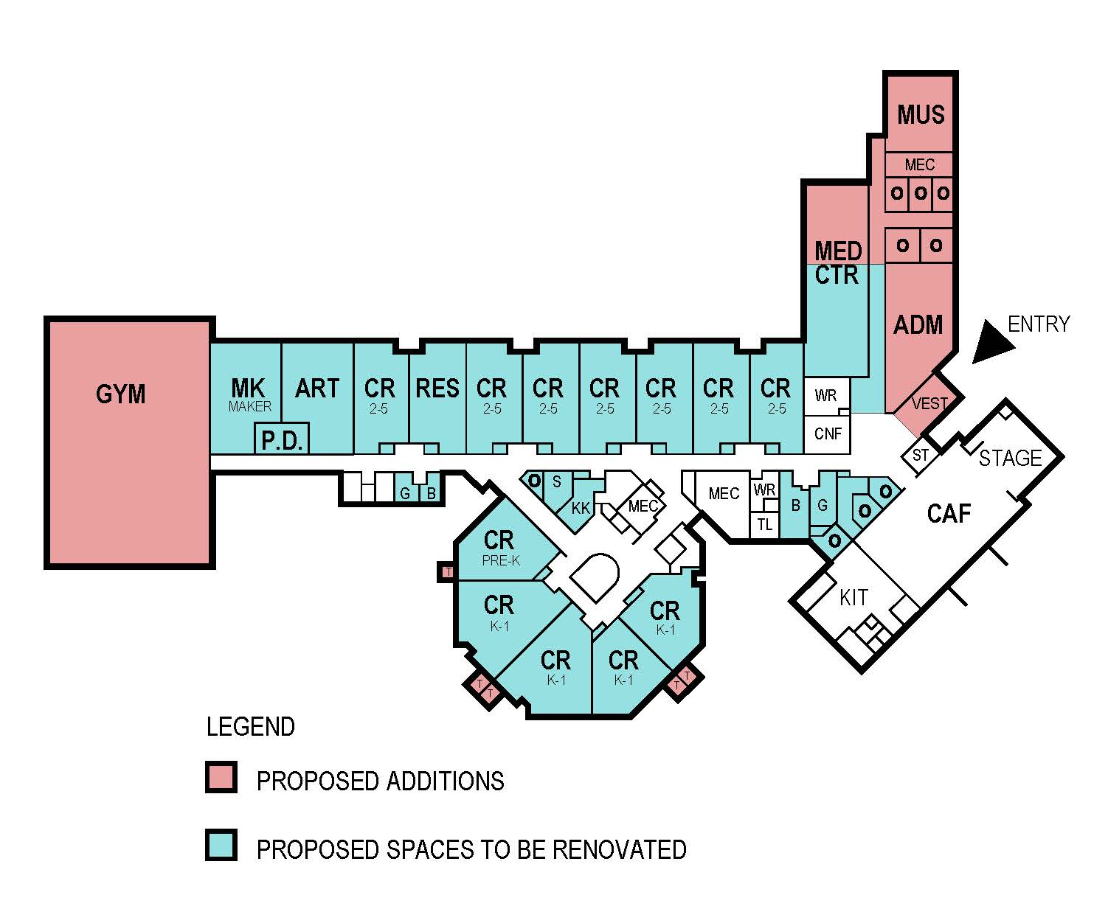
Red Hill Modernization
SCOPE
Additions (9,000 sf)
  An expanded Media Center
  A new Administration area & front entrance security improvements
  New music classroom
  A new Gymnasium and support spaces.
  Toilets for K-1 classrooms
The current gym will be repurposed into an art room & maker space.
Existing spaces will be renovated & modernized.
Site work will include additional parking, site improvements and outdoor learning areas.
Timing: Open for 2017/18 School Year
Total Budget: $5,914,000
Purpose: PARITY

Slide 8
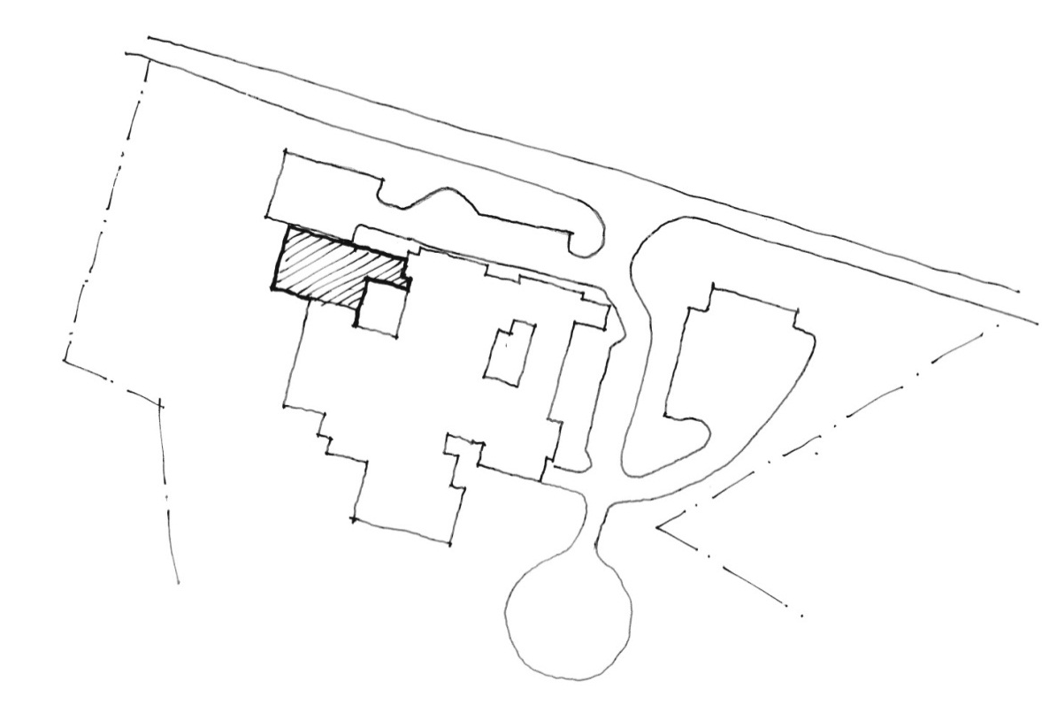
Stony Point Addition + Renovations
Timing: Open for 2017/18 School Year
Total Budget: $4,696,000
Purpose: CAPACITY
Building Capacity | Projected Enrollment
 | 13/14 | 14/15 | 15/16 | 16/17 | 17/18 | 18/19 | 19/20 | 20/21 | 21/22 | 22/23 | 23/24
225 | 209 | 255 | 250 | 265 | 259 | 268 | 261 | 269 | 264 | 256 | 252
Difference | -46 | -41 | -56 | -50 | -59 | -52 | -60 | -55 | -47 | -43 | -36
 | -20.4% | -19.6% | -22.0% | -20.0% | -22.3% | -20.1% | -22.4% | -21.1% | -17.5% | -16.3% | -14.1%
Notes:
School currently uses 4 trailers, two of which are grade level classes

Slide 9

Stony Point Addition + Renovations
SCOPE
Addition (6,000 sf)
  Four new classrooms
  Support spaces, restrooms, etc.
Improvements to the existing building include:
  Classroom modernization & new furniture
  Media Center renovation
  Kitchen Improvements/Upgrades
  Cafeteria Renovation
  Renovate bathrooms
  Renovate admin area
  New signage
  ADA Improvements

Slide 10
Learning Space Modernization
CLASSROOM FURNITURE UPGRADE
Update furniture to create a flexible & comfortable learning environment.
CLASSROOM MODERNIZATION
Renovate classroom spaces to update all finishes, casework, & lighting.
MEDIA CENTER RENOVATION
Renovate media centers to be flexible hubs of congregation, collaboration, & creation.
CAFETERIA RENOVATION
Update cafeteria finishes & furniture.
Renovate existing spaces to create state-of-the-art music, art, CTE & other specialty rooms.
SPECIALTY CLASSROOM RENOVATION
Daylighting
Add day lighting to spaces with no or minimal natural light.
This includes ergonomic seating choice, work surfaces that vary in height & size but are all mobile, & adequate storage.
Improve transparency & connection to adjacent spaces, including the outdoors if feasible.
This includes updating furniture, shelving, and accessory spaces.
Create dedicated maker spaces.
Update blinds or shades in spaces with natural light to better control the light.

Slide 11
Learning Space Modernization
10 Year Budget:
Scope | Price/Room |  | # of Rooms | Total
Classroom Furniture Upgrade | $15,000 |  | 781 | $11,715,000
Classroom Modernization | $50,000 |  | 725 | $36,250,000
Specialty Classroom Renovation: Art | $50,000 |  | 25 | $1,250,000
Specialty Classroom Renovation: CTE | $50,000 |  | 31 | $1,550,000
Specialty Classroom Renovation: Music | $25,000 |  | 32 | $800,000
Media Center Renovation | $125,000 |  | 17 | $2,125,000
Cafeteria Renovation | $125,000 |  | 16.5 | $2,062,500
Daylighting | $10,000 |  | 80 | $800,000
 |  |  | Subtotal: $56,552,500
 |  |  | Design/PM Fees: $5,655,250
 |  |  | Contingency (10%): $5,655,250
 |  |  | Total: $67,863,000

Slide 12
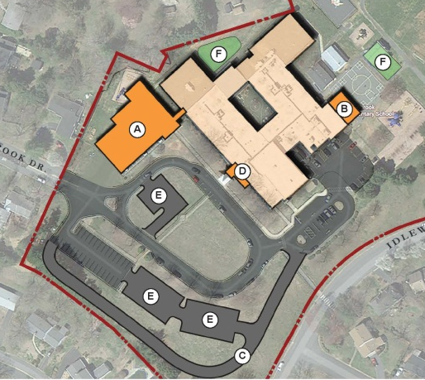
Woodbrook Addition & Modernization
Timing: Open for 2018/19 School Year
Renovation Complete for 2019/20 School Year
Total Budget: $14,262,000
Purpose: CAPACITY IN URBAN RING
School | Building Capacity | Projected Enrollment
 |  | 2013/14 | 2014/15 | 2015/16 | 2016/17 | 2017/18 | 2018/19 | 2019/20 | 2020/21 | 2021/22 | 2022/23 | 2023/24
Agnor-Hurt | 566 | 489 | 512 | 517 | 530 | 546 | 553 | 554 | 555 | 568 | 586 | 601
 | Difference | 77 | 54 | 49 | 36 | 20 | 13 | 12 | 11 | -2 | -20 | -35
Greer | 493 | 516 | 523 | 515 | 529 | 516 | 514 | 493 | 501 | 514 | 525 | 536
 | Difference | -23 | -30 | -22 | -36 | -23 | -21 | 0 | -8 | -21 | -32 | -43
Hollymead | 448 | 451 | 466 | 466 | 468 | 475 | 474 | 466 | 464 | 469 | 476 | 483
 | Difference | -3 | -18 | -18 | -20 | -27 | -26 | -18 | -16 | -21 | -28 | -35
Woodbrook | 296 | 332 | 327 | 334 | 337 | 334 | 343 | 328 | 331 | 332 | 333 | 342
 | Difference | -36 | -31 | -38 | -41 | -38 | -47 | -32 | -35 | -36 | -37 | -46
TOTAL | 1803 | 1788 | 1828 | 1832 | 1864 | 1871 | 1884 | 1841 | 1851 | 1883 | 1920 | 1962
 | Difference | 15 | -25 | -29 | -61 | -68 | -81 | -38 | -48 | -80 | -117 | -159
Notes:
Comment on current figures
Greer trailer
Option to do a smaller addition

Slide 13
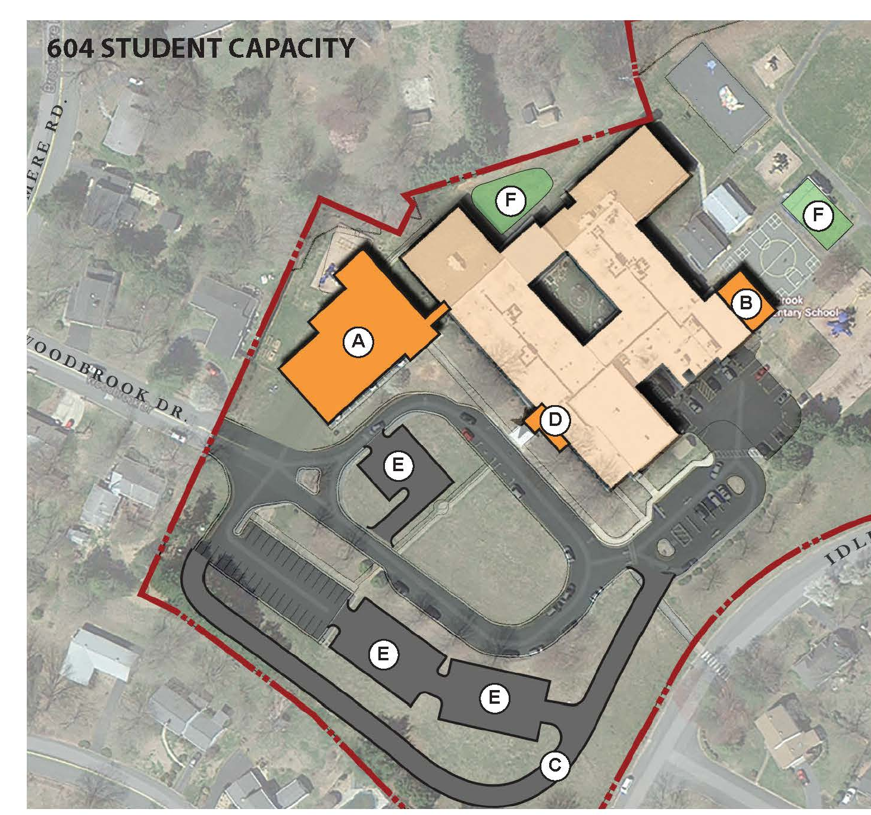
Woodbrook Addition & Modernization
SCOPE
Additions (40,000 sf)
  16 classrooms (2 story)
  2 SPED Rooms
  Maker Space
  Professional Development training space
  Expanded Cafeteria
  A new Gymnasium and support spaces.
Improvements to the existing building
Notes:
Acknowledge that this is bigger than the projections call for. Due to the central location of the school, trends of growth after Greer addition and potentially Agnor-Hurt growth. The increased size is justified. Additional space could be used for other programs as well.
There is a smaller alternative if the Board would like it for consideration.

Slide 14
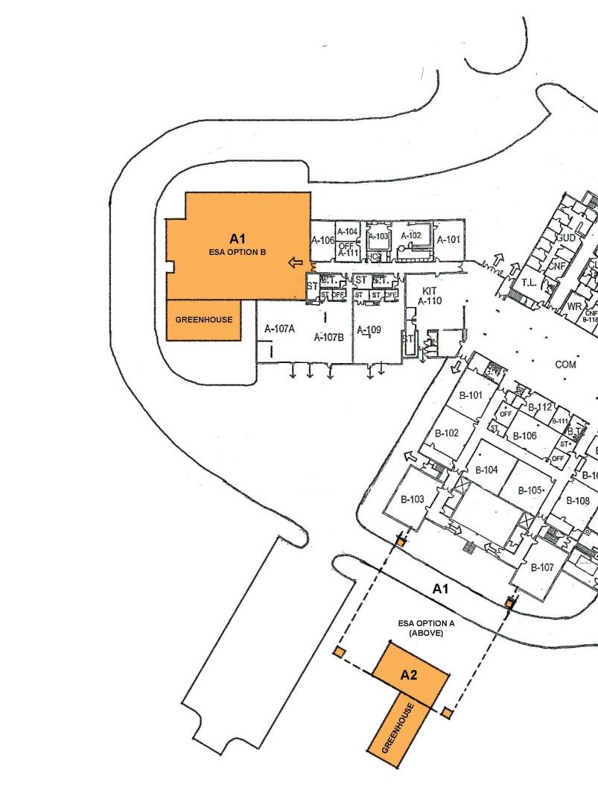

WAHS Environmental Science Academy
Timing: Phase 1 Open for 2015/16 School Year
Phase 2 Open for 2020/21 School Year
Total Budget: Phase 1 $600,000
Phase 2 $2,200,000
Purpose: Support School Board Initiative
Notes:
Note change in Greenhouse figure. Updated estimate.

Slide 15
WAHS Environmental Science Academy
SCOPE
Phase 1: Greenhouse
  2100 sf collegiate glass greenhouse
  800 sf Attached Classroom
  400 sf Storage
  Furnishings & Equipment
Phase 2: Academy Addition
  10,000 sf
  Three science labs, “dark room” / planetarium, offices, a shared prep room with storage, and project spaces for independent, collaborative teaming.
  Spaces will accommodate hydro / aqua activities and hydroponics.

Slide 16
Prioritization
LRPAC Recommendation
Alternate #1
RANK | PROJECT
8 | Red Hill Additions + Modernization
9 | Stony Point Addition + Modernization
10 | Learning Space Modernization
11 | Woodbrook Addition + Modernization
12 | WAHS Environmental Science Academy
RANK | PROJECT
8 | WAHS Environmental Science Academy
9 | Red Hill Additions + Modernization
10 | Stony Point Addition + Modernization
11 | Learning Space Modernization
12 | Woodbrook Addition + Modernization
Alternate #2
Alternate #3
RANK | PROJECT
8 | WAHS Environmental Science Academy
9 | Learning Space Modernization (including Red Hill, Stony Point & Woodbrook)
10 | Red Hill Additions
11 | Stony Point Addition + Modernization
12 | Woodbrook Addition + Modernization
RANK | PROJECT
8 | WAHS Environmental Science Academy
9 | Woodbrook Addition + Modernization
10 | Stony Point Addition + Modernization
11 | Red Hill Additions + Modernization
12 | Learning Space Modernization

